Slide 2
The game is played on a M by N grid of `cells', each of which is either empty or contains an explosive mine.

Slide 3
The program will indicate how many of the revealed cell's eight neighbours do contain mines. Any neighbouring empty cells will also be revealed in the same way. Together these should provide you with enough information to determine where the mines are hidden. The game is over (and you have won) when the number of unrevealed cells is equal to the number of mines on the board (since every unrevealed cell must then contain a mine).

Slide 4
Operating System: Windows XP or later
Processor: Intel Pentium or higher
RAM:512 MB
Mouse or trackpad required

Slide 5
CodeBlocks v.16.01,v.10.05
GNU C++ Compiler

Slide 6
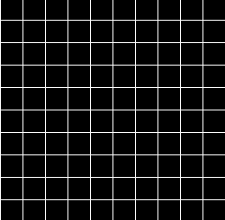
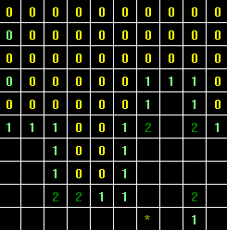
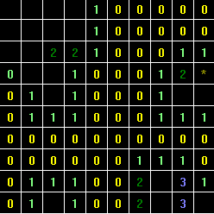

Slide 7
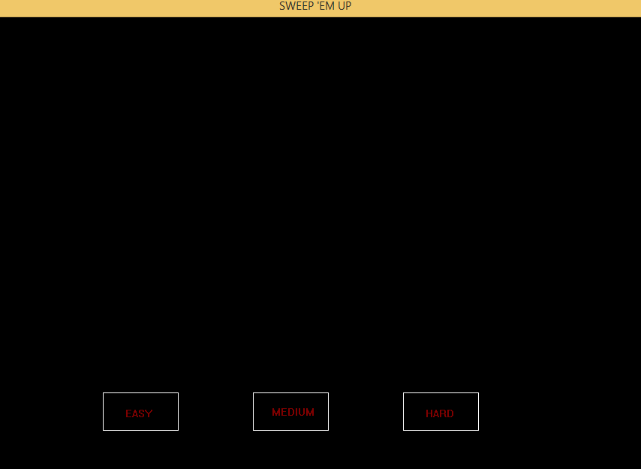
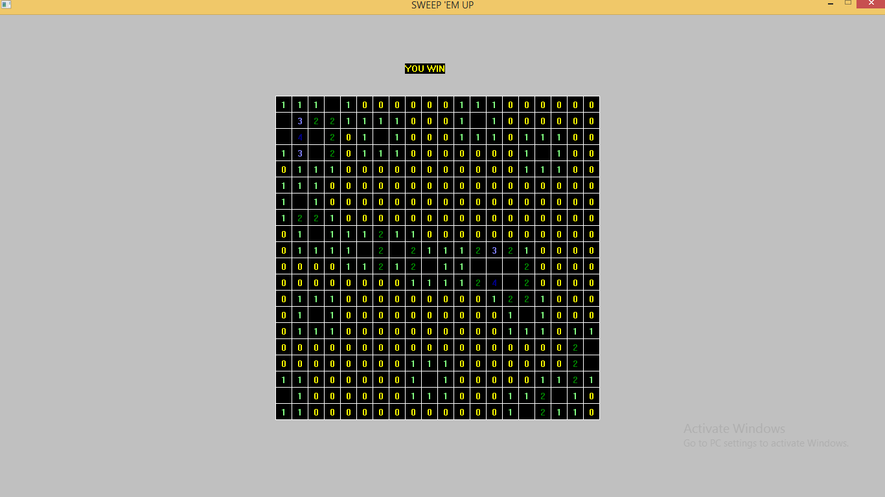

Slide 8
We would like to make the mobile versions of the game and provide more animations, features and game modes as the number of users grow. We would also like to make a score-based game mode so that users can compete with their friends thereby increasing popularity of the game.

